Slide 1
Cryptographic techniques
Dr. O. I. Adelaiye

Slide 2
Secret Key cryptography
SYMMETRIC CRYPTOGRAPHY

Slide 3
Why is it important
Secret key cryptography: Common uses
Confidentiality: sender and receiver share a secret and use it to communicate
Secure storage: encrypt content before storing it
Authentication: share a key and prove that you know it when being authenticated
Integrity: instead of having a simple cleartext checksum, encrypt it !
becomes Message Integrity Check or Code

Slide 4
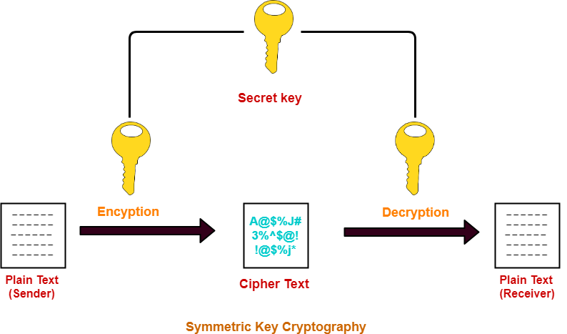

Slide 5
Block Vs Stream Cipher
Two different techniques (algorithms)
Stream ciphers: can encrypt any size
Are based on random number generators
The generated random number string has the same size as the data
Block ciphers: encrypt fixed size blocks
The data to be encrypted is split into blocks of a predefined size
If the block is smaller than that size, then padding bits are added before encryption (e.g. add zeros at the end)
Example: DES and IDEA use 64 bit blocks, AES uses 128 bit block

Slide 6
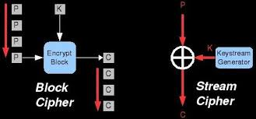

Slide 7
Stream cipher

Slide 8
Stream cipher
Stream cipher
Generates a random string: Keystream
Not to be confused with the shared Key
XORs it with the message to be encrypted
The random string is not really random
Pseudo-random
The pseudo-random string is used only once
One-time pad
RC4 is one of the most widely known stream ciphers
Used in WEP and in one version of WPA (TKIP)
Designed in 1987 and leaked out in 1994
Ron’s (Rivest) Code?
Rivest Cipher 4?

Slide 9
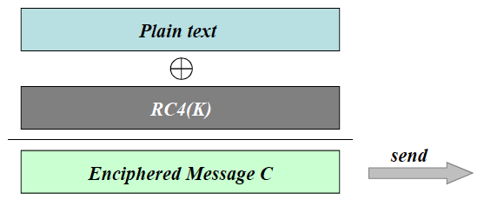
Stream cipher
RC4
Simple to deploy
Off-line phase
1 to 256 bytes key
8 bytes key is used in WEP(Wired Equivalent Privacy)

Slide 10
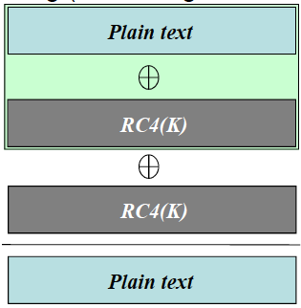
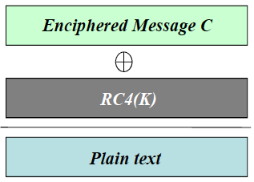
Stream cipher
RC4
Decipher by XORing the enciphered message with the same pseudo-random string (can be regenerated using the same key K)

Slide 11
Stream cipher
RC4
Very easy to implement
Light-weight
But light security !
The first few generated bytes give insight on the used key
Avoid using the first 256 bytes
Not used anymore in new " secure” systems
Still a good pseudo-numbers generator though

Slide 12
Block cipher

Slide 13
Block cipher
Encryption of a fixed length block
Defined by the encryption algorithm
The size of a block should be small enough to avoid wasting resources
Imagine a block size of 1GB !
The size of a block should be big enough to prevent crackers from building dictionaries
Imagine a block size of 1 bit !
A message 1100 will be deciphered as either 0011 or 1100
The number of possibilities is 2^{block_size}
The cracker does not need to know the key
64 bits was considered to be a reasonable block size in 1970s: DES and later on IDEA
The more recent AES uses 128 bits

Slide 14
How encryption works?
Needs a technique that maps inputs (cleartext) to outputs (ciphertext) and vice versa
Has to be one-to-one, otherwise a ciphertext could be decrypted to many possible cleartexts
Two techniques
Permutation: changes positions of bits
1st becomes 7th, 2nd becomes 5th , etc.
n! permutations (where n is the number of bits), n! = n.(n-1).(n-2)… 1
Substitution: replaces n bits by n other bits
Works like a dictionary
E.g. 0000 is replaced by 1010; 0001 by 1100; 0010 by 1001, etc.
2^{n} possible outputs for each input
Can be combined as many times as needed

Slide 15
Lets create a block cipher
Gordon’s cipher: block size is 16 bits, key size is 1 bit
Combines both substitution and permutation to create a cipher
Start with substitution
Divide the block (say 16 bits) into smaller chunks (2 bits each)
Apply the substitution on each chunk
00 > 10
01 > 11
10 > 00
11 > 01
Then, apply permutation: reorder bits
1,2,3,4, 5, 6, 7, 8, 9,10,11,12,13,14,15,16 becomes
2,4,6,8,10,12,14,16,15,13,11,9 , 7 , 5, 3 ,1

Slide 16
Lets create a block cipher
Gordon’s cipher: block size is 16 bits, key size is 1 bit
Oups ! the key has not been used !
XOR the key with each chunk (two bits) after the permutation
Example: encrypt 11 00 10 01 00 11 00 11 with key " 1
After substitution: 01 10 00 11 10 01 10 01
After permutation:
After XOR with the key:
Note that modifying one bit in the input > modify one or two bits in the output

Slide 17
Lets create a block cipher
This process is repeated many times (rounds)
Otherwise, one input bit impacts only two output bits
Is this process reversible?
Is it important to be reversible?

Slide 18
Data encryption standard (DES)

Slide 19
DES
Published in 1977
By the National Bureau of Standards
Became the National Institute of Standards and Technology (NIST)
Encrypts 64 bit blocks into 64 bit blocks
Uses a 64 bit key
Not really! 8 bits are odd parity bits: a parity bit per octet: 64 - 8 = 56 bit key
Designed to be implemented in hardware
Based on IBM’s Lucifer Cipher

Slide 20
DES
Initial permutation, then 16 rounds, then final swap and final permutation
In each round
The 56 bit key is used to generate a new 48 bit round key
A 64 bit input is converted into 64 bit output
Decryption is done by running the rounds backwards
Initial permutation is still done first in decryption (cancels the final permutation done in encryption)
Final swap and permutation still done at the end

Slide 21
Permutations
Initial permutation
Place even columns before odd ones
2,4,6,8,1,3,5,7
Rotate clockwise
Final permutation: cancels the initial permutation

Slide 22
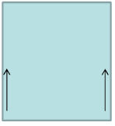
Rounds
Reminder: the key has 8 parity bits
56 useful bits: 1-7;9-15;17-23; … ;57-63
Initialisation
Permutation
Split the key into two halves: C₀ and D₀
Round i
Shift C_{i} and D_{i} by one or two bits to the left
Permute (again!) each of the two halves, the result of the permutation is the round key
The permutation on each half discards 4 bits of it > the round key is 56 But 48 bits only are selected (Left Choice Shift)

Slide 23
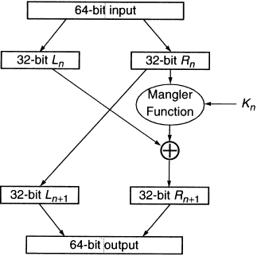
ROUNDS
Round I
Input: L_{i} and R_{i}
Output: L_{i+1} and R_{i+1}
L_{i+1} = R_{i}
R_{i+1} = f(R_{i},K_{i}) Li
f is the mangler function
Takes a 32 bit R and 48 bit K
Split R into blocks of 4 bits
Expand each 4 bit block by adding the surrounding bits (i.e. +1 bit from each side)
Becomes 6 bits
Split K into blocks of 6 bits and XOR them with R’s blocks
The outputs are eight 6 bit long blocks and each will be mapped using a S-box to 4 bits
Final output is 8x4=32 bits long and is the new R

Slide 24
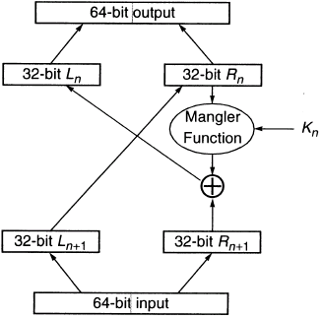
DECRYPTION
Decryption
Use exactly the same round algorithm
Input: R_{i+1} , L_{i+1} , K_{i} (note that the inputs are swapped)
Output: R_{i} , L_{i}

Slide 25
Observations
Key size
The 8 parity bits are useless with not important use in practice
Lucifer’s key was 128 bits and got reduced to 56 bits in DES
Justification: so DES could be implemented on a single chip
Initial and final permutations useless
If DES is insecure without permutations then it is insecure with permutations
Key permutations are useless
Same argument
The rational behind the S-boxes is unknown
Justification: some secret attacks were considered during the design and they should not be made public
NSA contributed to them !

Slide 26
Observations
In 1999, NIST advised not to use it in any new systems
3DES could be used
Three successive DES: encryption, decryption, then encryption
This makes a 3DES chip able to perform DES by setting all the keys to the same value
Two keys (1st and 3rd DES use the same), or three keys
Similar concepts (rounds, per-round keys, etc.) are used in IDEA and AES

Slide 27
Modes of operation

Slide 28
Why?
DES and all other block encryption algorithms can encrypt a fixed size
What happens if you need to encrypt a message longer than one block?
Modes of operation describe how to encrypt a message larger than one block
The first four modes were introduced in 1981 for DES
ECB, CBC, OFB, and CFB
CTR added in 2001 by NIST

Slide 29
Electronic code block (ECB)
Simply encrypt each 64 bit block separately
Last block is padded to get 64 bits length
Encryption can be parallelized (same for decryption)
Problems
Two identical blocks produce the same ciphertext
Blocks could be rearranged by the attacker
Swap a clerk’s salary with the CEO’s

Slide 30
Output feedback (OFB)
Works as a stream cipher (computes a keystream)
An IV, b₀ is encrypted to generate b₁
Then, b₁ is encrypted to generate b₂ and so on
b₀ | b₁ | b₂ | … is the one-time pad
Has the advantages of stream ciphers
Can prepare the keystream in advance (offline)
As a byte arrives it can be sent (no need to wait for a complete 64 bit block to arrive)
If some bits are flipped en route in a given block, following block still can be decrypted correctly
Problems
Known cleartext, ciphertext attack is fatal
XORing them gives the keystream
XORing two ciphertexts whose keystreams are equal could reveal one cleartext if the other is known

Slide 31
Cipher feedback
Similar to OFB but
Instead of having b_{i+1} = E_{DES}{b_{i}}, now b_{i+1} = E_{DES}{b_{i} Block_{i}}
Block_{i} is the i^{th} block of plaintext
Avoids OFB’s problems
Problems
Keystream cannot be computed offline

Slide 32
Counter (CTR)
Computes a keystream offline
Generates a random iv then
Encrypts iv in order to generate b₀
Encrypts iv+1 in order to generate b₁ and so on
Can start decryption at any block
Problems
Known cleartext, ciphertext attack
XORing two ciphertexts whose keystreams are equal

Slide 33
END

